Slide 1

Energy Usage Management
IST687 M004 Group1
Sai Akash Addala
Sai Mani Kiran Chatrathi
Himanshu Hedge
Deep Chandrebhai Patoliya
Zimin Zhu

Slide 2
What are we trying to solve?
How are we solving it?
What is the data telling us?
Predictions for July 2019
What drove energy consumption?
Insights and Recommendations

Slide 3

What are we trying to solve?

Slide 4

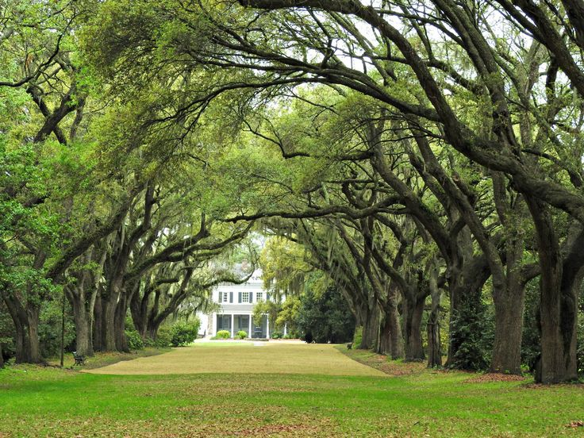
Current State vs Desired State
eSC lacks visibility into the Key drivers of Total Energy Consumption in the state of South Carolina.
​
They are anticipating a surge in energy consumption next summer and want to quantify it.
​
Take steps to reduce energy usage next summer
Complete insight into the key drivers of energy consumption.​
Energy consumption forecasts for next July across different regions and attributes. ​
Actionable recommendations to reduce energy consumption with quantifiable impact.

Slide 5

How are we solving it?

Slide 6
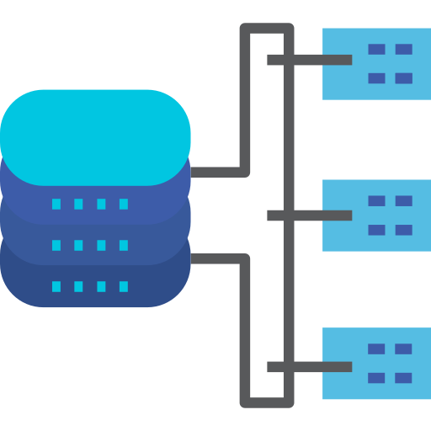




Data Ingestion
Ingest Static House Data, Energy Data and Weather Data.
Pre-process data and merge the files together to form master dataset.
Feature Engineering
Creating new features/modifying existing ones, to be fed into the regression model.
Null Value Treatment.
Ordinal and One-Hot Encoding.
Feature selection based on correlation and other methods.
Modelling
Build and test regression models to understand key drivers of energy consumption.
Choose best performing model, forecast surge in energy consumption.
Insight Generation and Visualization
Suggest recommendations and quantify impact based on EDA, Modelling and Forecasts.
Build a user-friendly and interactive R-Shiny Dashboard interface to visualize the results.
Exploratory Data Analysis
Understanding Feature datatypes.
Missing value analysis.
Summary statistics.
Univariate and Bivariate Analysis.

Slide 7

What is the Data telling us?

Slide 8



Static House Data for 5710 buildings in 46 counties:
Building Geographic Attributes
Building Electric, Insulation, Cooling, Water, Fuel and Gas Appliance Attributes.
House Size, Occupants, Garage
Heating and Cooling setpoints
Income
Total energy consumption per building:
Electricity consumption
Heater Consumption
Cooler Consumption
Hot water and Gas Consumption
Weather Data
Outside Temperatures
Radiation Levels
Humidity
Wind Speed

Slide 9
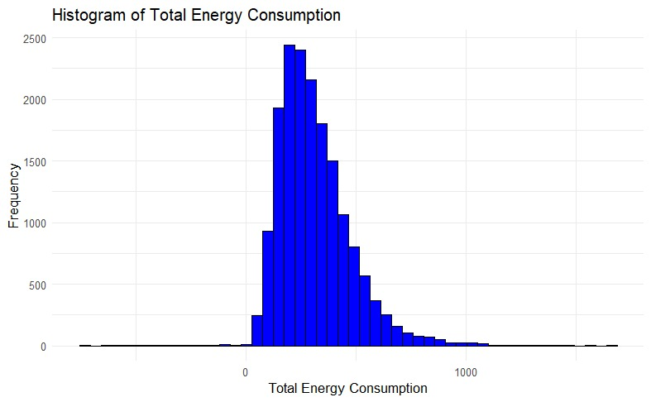
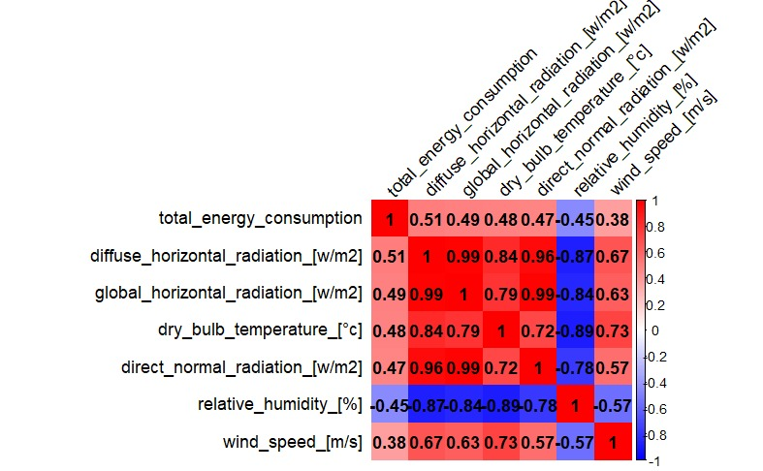
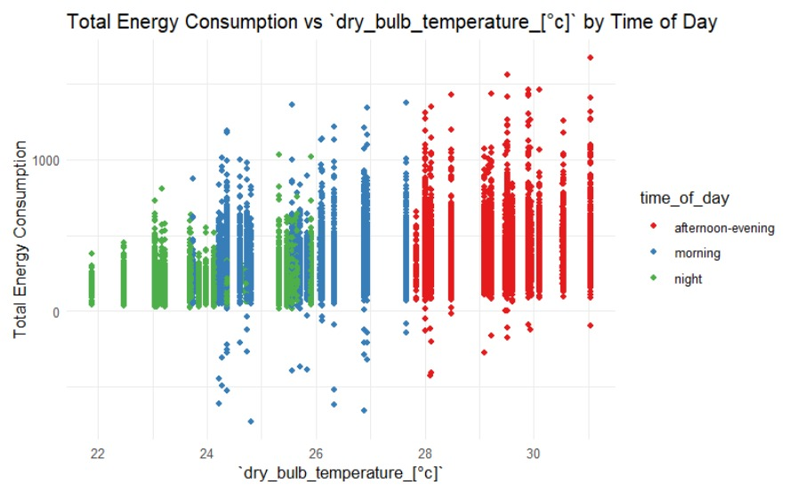
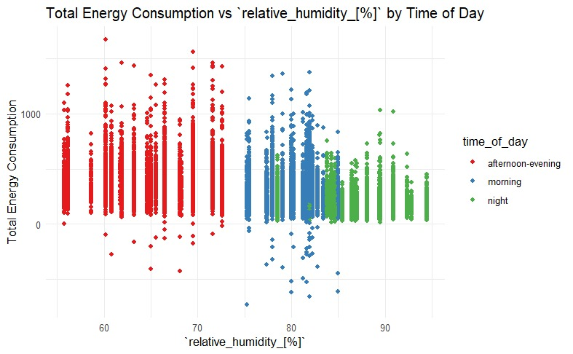

Slide 10



Predictions : July 2019 Energy Consumption - South Carolina
July 2018
5,055,643 kWh
+5C
July 2019
Surge
5,983,238 kWh
18.34%

Slide 11










Breakdown of July 2019 Surge
23%
22%
5 %
18%
Counties | Surge %
16 | 20-25
18 | 15-20
12 | 10-15
40%
16%

Slide 12
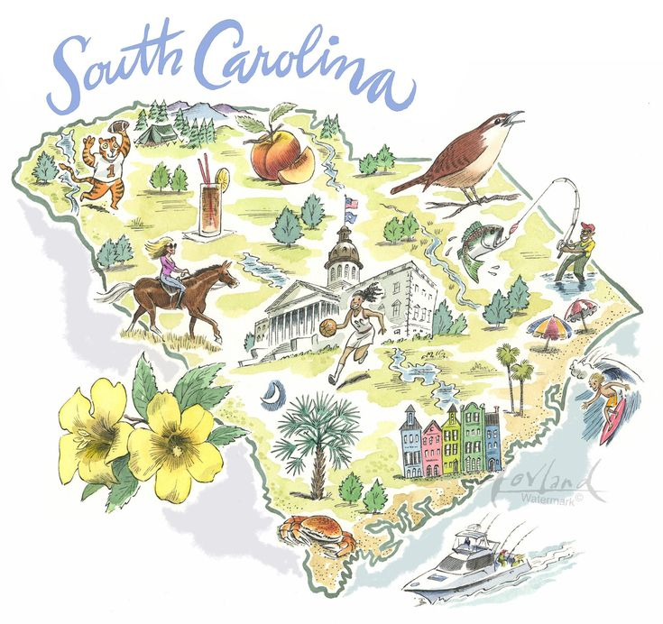
What drove energy consumption?

Slide 13
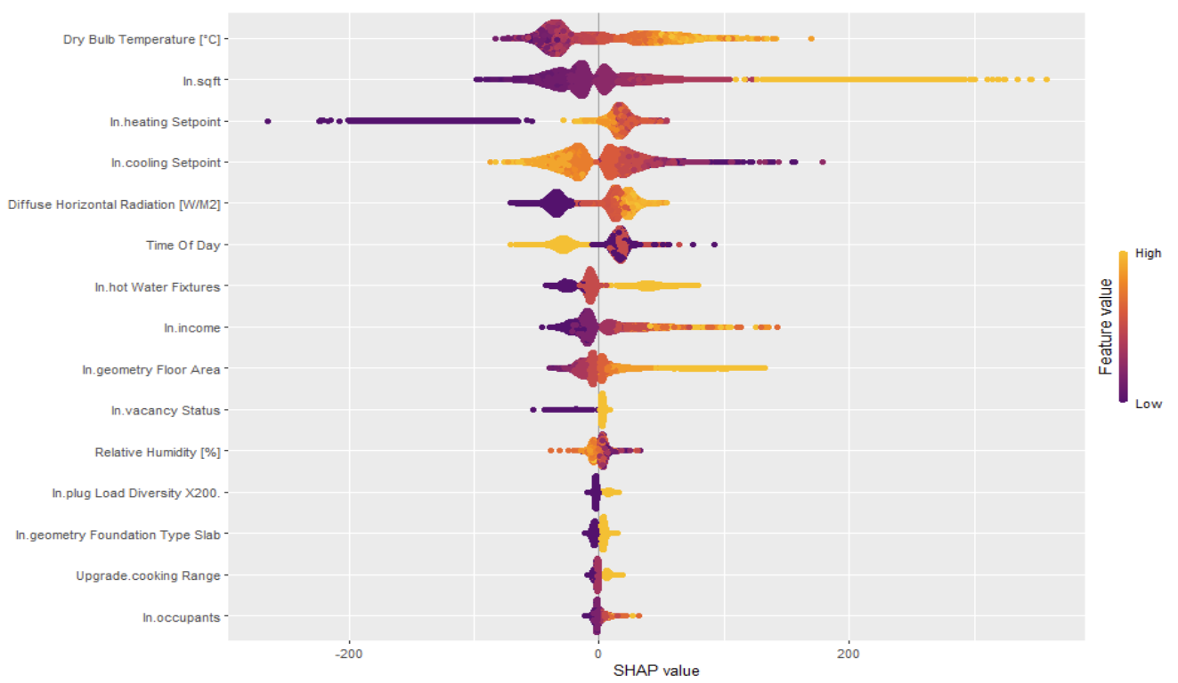
Marginal Impact on Total Energy Consumption

Slide 14
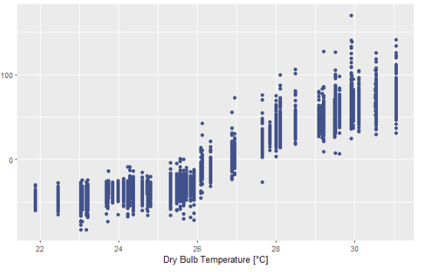
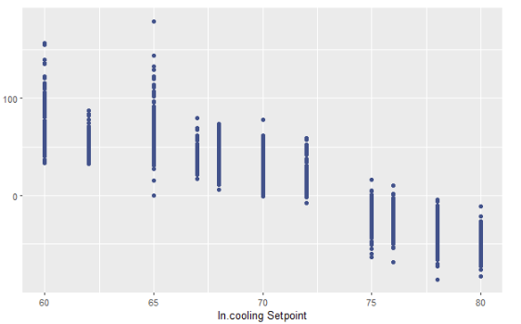
Impact on Total Energy Consumption
Marginal Impact of Feature
Increasing outside temperatures from 22C to 26C has no impact on building Energy Consumption.
Once temperature crosses 26C, there is an impact of 60 kWh per degree per building.
Impact on Total Energy Consumption
Dry Bulb Temperature
There is an average impact of - 18.75 kWh per building per degree Fahrenheit as the building thermostat temperature increases from 60F (15C) to 80CF (26C).

Slide 15
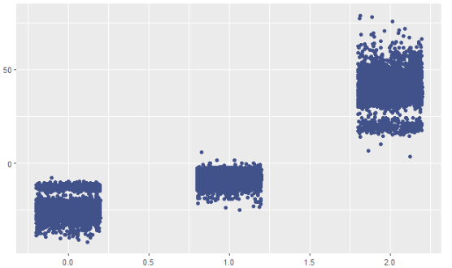
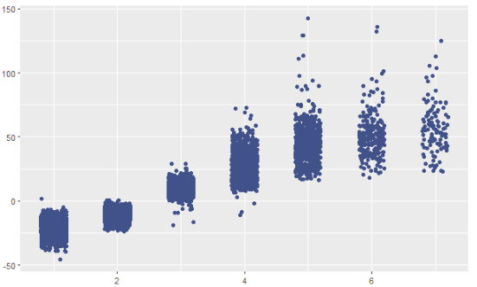
Impact on Total Energy Consumption
Marginal Impact of Feature
Buildings that have 200% hot water fixture usage cause a 225 kWh increase in energy consumption per building than those who have 100% hot water fixture usage.
50% Usage
100% Usage
200% Usage
Hot Water Consumption
Impact on Total Energy Consumption
The contributions of high-income households ($30,000>) to total energy consumption are the same :150 kwh per building above the average energy consumption.
Below this, energy consumption increases 75 kWh per building per $5000 increase in Income.
$15,000
$25,000
$35,000
Income

Slide 16

Recommendations

Slide 17
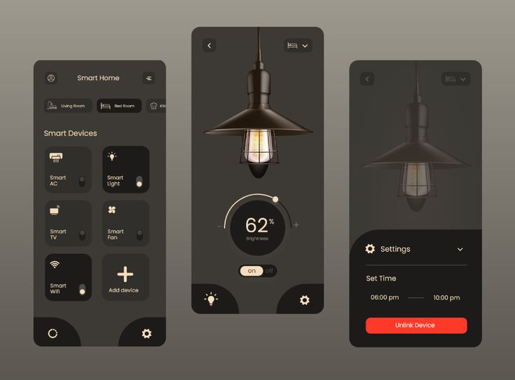

Launch campaigns to encourage adoption of Smart Appliances in buildings. ​
18 kWh/˚C of energy per building can be saved by dynamically controlling Cooling Setpoint. ​
Conduct state wide campaigns to reduce Hot Water Fixture Costs. Ensure fix leaks, install low-flow fixtures, insulate accessible hot water lines, and purchase an ENERGY STAR certified dishwasher and clothes washer.
225 kWh of energy per building can be saved by reducing fixture usage from 200% to 100%.

Slide 18

Models and Accuracy

Slide 19
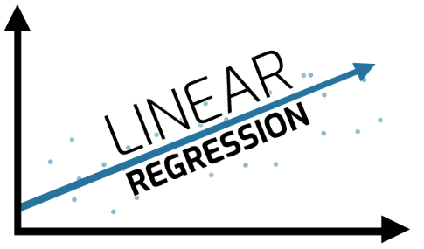


Linear Regression was our baseline model
Due to high dimensionality of the data, presence of categorical variables and non-linear distributions in the data – CatBoost and XGBoost were chosen.
Accuracy : 75%
MAPE: 25
R-squared: 75%
Accuracy : 82%
MAPE: 18
R-squared: 82%
Accuracy : 82%
MAPE: 18
R-squared: 84%

Slide 20
Thank You
Sai Akash Addala
Sai Mani Kiran Chatrathi
Himanshu Hedge
Deep Chandrebhai Patoliya
Zimin Zhu

Slide 21
Appendix

Slide 22

Data Ingestion
1. Ingest Static House Data, Energy Data and Weather Data.
2. Pre-process data and merge the files together to form master dataset.

Slide 23

Exploratory Data Analytics
1. Understanding Feature datatypes.
2. Missing value analysis.
3. Summary statistics.
4. Univariate and Bivariate Analysis.

Slide 24
Feature Engineering
Creating new features or modifying existing ones, to be fed into the regression model.
2. Null Value Treatment.
3. Ordinal and One-Hot Encoding.
4. Feature selection based on correlation and other methods.

Slide 25
Modeling
1. Build and test regression models to understand key drivers of energy consumption.
2. Choose best performing
model, forecast surge in energy consumption.

Slide 26

Insight Generation and Visualization
Suggest recommendations and quantify impact based on EDA, Modelling and Forecasts.
2. Build a user-friendly and interactive R Shiny
Dashboard interface to visualize the results.

Slide 27
Project Goals
The dataset focused on July energy usage to understand the key drivers. And how we could encourage our customers to save energy.
We build three different models to predict the energy usage for July and create a new weather dataset to show the future energy demand.
A shiny application allows our client to interact with data.
One potential approach we identified to reduce peak energy demand.

Slide 28
Dataset Characteristics
Energy usage information
We build three different models to predict the energy usage for July and create a new weather dataset to show the future energy demand.
A shiny application allows our client to interact with data.
One potential approach we identified to reduce peak energy demand.

Slide 29

eSC lacks visibility into the Key drivers of Total Energy Consumption in the state of South Carolina.
​
They are anticipating a surge in energy consumption next summer and want to quantify it.
​
Take steps to reduce energy usage next summer
Complete insight into the key drivers of energy consumption.​
Energy consumption forecasts for next July across different regions and attributes. ​
Actionable recommendations to reduce energy consumption with quantifiable impact.

Slide 30




2019 South Carolina Energy Consumption Forecast
22%
18%
16%
July 2019
5983238 kWh

Slide 31
2019 South Carolina Energy Consumption Forecast
Counties | Surge %
16 | 20-25
18 | 15-20
12 | 10-15
Surge
18.34%

Slide 33
Linear Regression was our baseline model
Due to high dimensionality of the data, presence of categorical variables and non-linear distributions in the data – CatBoost and XGBoost were chosen.
Accuracy : 75%
MAPE: 25
R-squared: 75%
Accuracy : 82%
MAPE: 18
R-squared: 82%
Accuracy : 82%
MAPE: 18
R-squared: 84%

Slide 34
Data Ingestion
Ingest Static House Data, Energy Data and Weather Data.
Pre-process data and merge the files together to form master dataset.
Feature Engineering
Creating new features/modifying existing ones, to be fed into the regression model.
Null Value Treatment.
Ordinal and One-Hot Encoding.
Feature selection based on correlation and other methods.
Modelling
Build and test regression models to understand key drivers of energy consumption.
Choose best performing model, forecast surge in energy consumption.
Insight Generation and Visualization
Suggest recommendations and quantify impact based on EDA, Modelling and Forecasts.
Build a user-friendly and interactive R-Shiny Dashboard interface to visualize the results.
Exploratory Data Analysis
Understanding Feature datatypes.
Missing value analysis.
Summary statistics.
Univariate and Bivariate Analysis.

